Slide 1





prioritizr Systematic conservation planning in
prioritizr.net
Richard Schuster & Jeffrey Hanson
richard.schuster@glel.carleton.ca
jeffrey.hanson@uqconnect.edu.au
Acknowledgements: Nina Morrell, Matt Strimas-Mackey, Matt Watts,
Peter Arcese, Joe Bennett, Hugh Possingham

Slide 2

prioritizr
Design your problem
Find optimal solutions
Ideally, fast!

Slide 3
Why ?
It’s free
Reproducibility
Flexible interface
Diverse package ecosystem
So many resources: Stackoverflow, tutorials, blogs, twitter, slack channels, mailing lists

Slide 4
Human-readable code
Mental model
problem <- data +
objective +
constraints +
penalties +
decision type +
solver
solution <- solve(problem)

Slide 5
Human-readable code
Mental model
Code
problem <- data +
objective +
constraints +
penalties +
decision type +
solver
solution <- solve(problem)
p <- problem(areas, feats) %>%
add_min_set_objective() %>%
add_relative_targets(0.1) %>%
add_boundary_penalties(5) %>%
add_binary_decisions() %>%
add_rsymphony_solver()
solution <- solve(p)

Slide 6
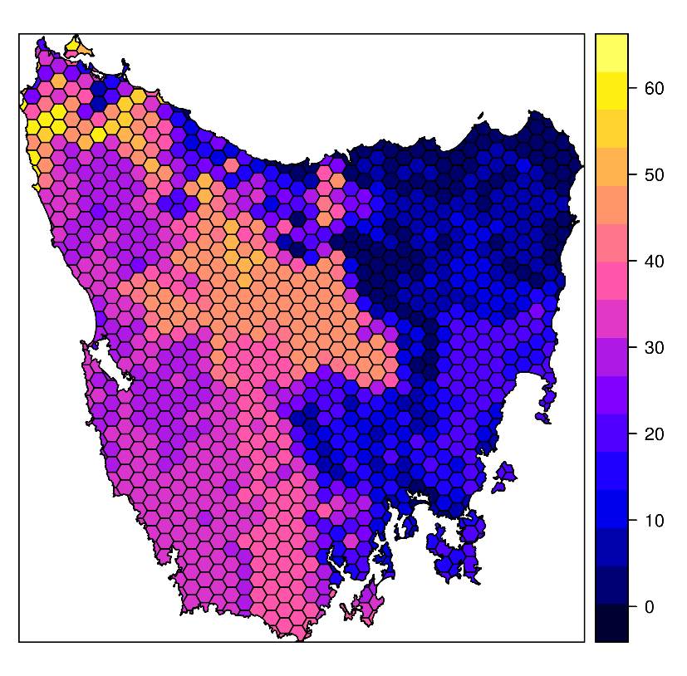
Design your problem
Study area: Tasmania, Australia
Planning units: 1130 hexagons
Features: 63 vegetation types

Slide 7
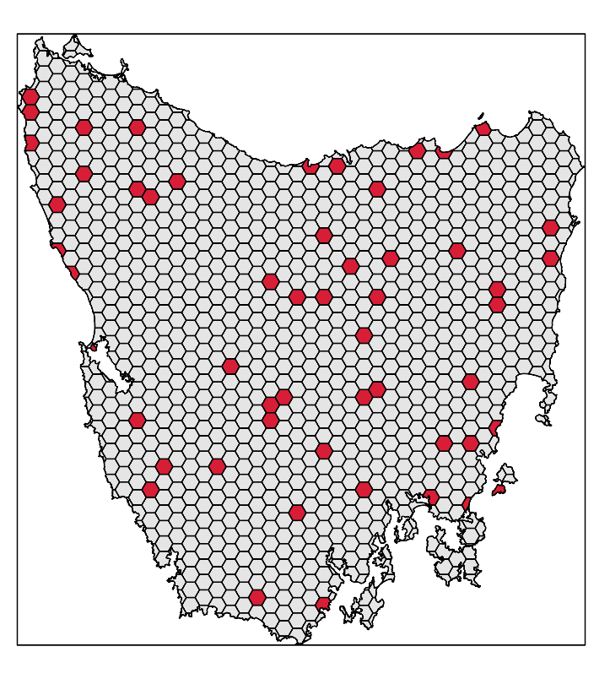
Design your problem
problem(tas_pu, tas_features,
"cost") %>%
add_min_set_objective() %>%
add_relative_targets(0.1) %>% add_binary_decisions() %>%
add_gurobi_solver(gap = 0) %>% solve()

Slide 8
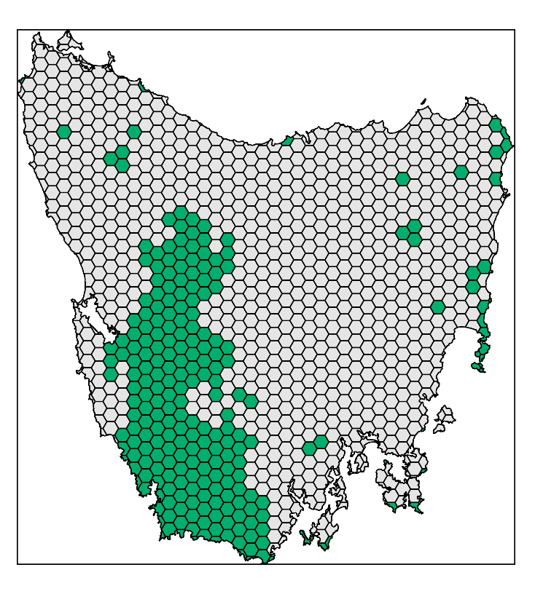
Design your problem
problem(tas_pu, tas_features,
"cost") %>%
add_min_set_objective() %>%
add_relative_targets(0.1) %>% add_locked_in_constraints("in") %>%
add_binary_decisions() %>%
add_gurobi_solver(gap = 0) %>% solve()

Slide 9
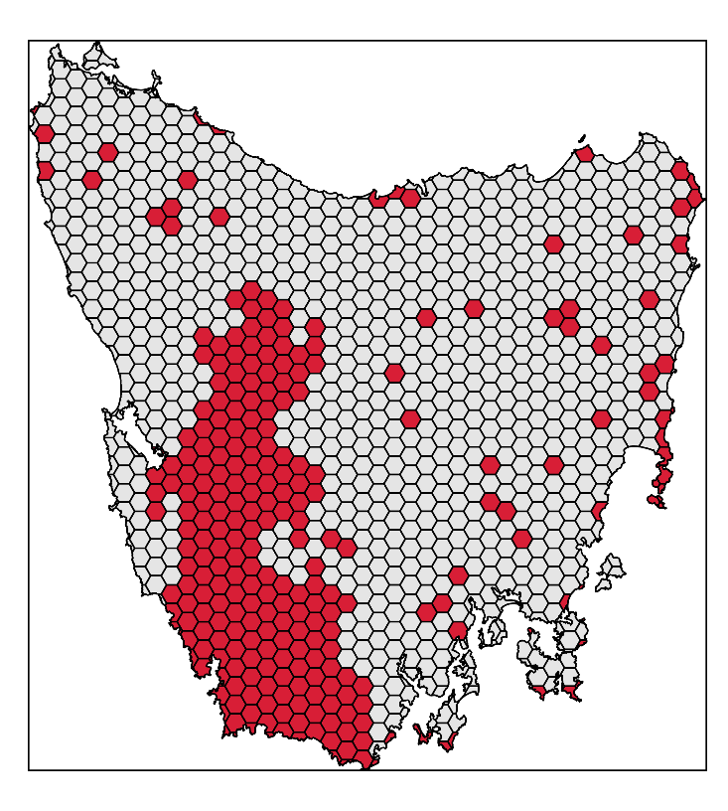
Design your problem
problem(tas_pu, tas_features,
"cost") %>%
add_min_set_objective() %>%
add_relative_targets(0.1) %>% add_locked_in_constraints("in") %>%
add_binary_decisions() %>%
add_gurobi_solver(gap = 0) %>% solve()

Slide 10
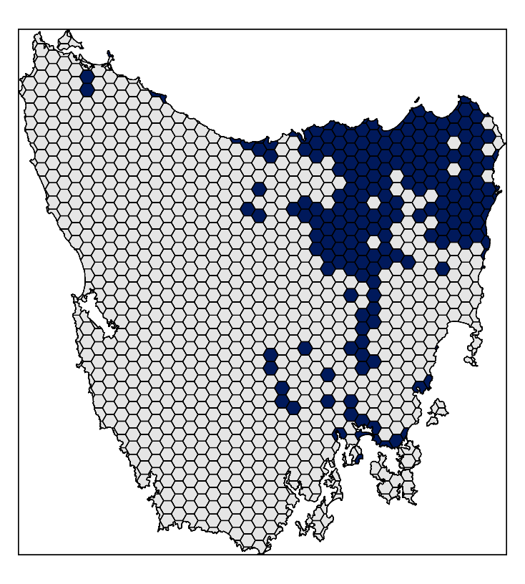
Design your problem
problem(tas_pu, tas_features,
"cost") %>%
add_min_set_objective() %>%
add_relative_targets(0.1) %>% add_locked_in_constraints("in") %>%
add_locked_out_constraints("out") %>%
add_binary_decisions() %>%
add_gurobi_solver(gap = 0) %>% solve()

Slide 11
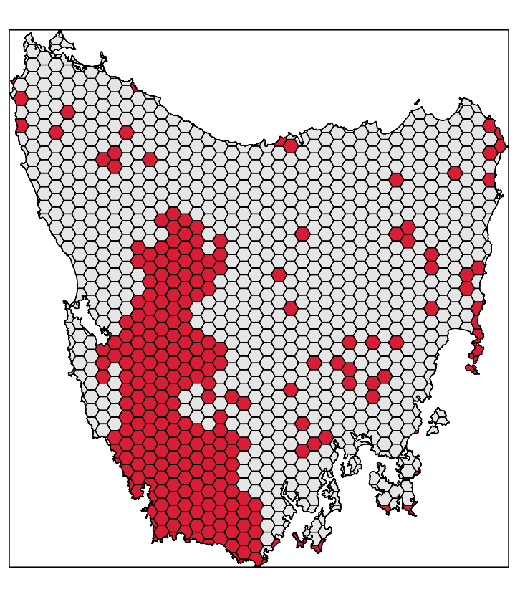
Design your problem
problem(tas_pu, tas_features,
"cost") %>%
add_min_set_objective() %>%
add_relative_targets(0.1) %>% add_locked_in_constraints("in") %>%
add_locked_out_constraints("out") %>%
add_binary_decisions() %>%
add_gurobi_solver(gap = 0) %>% solve()

Slide 12
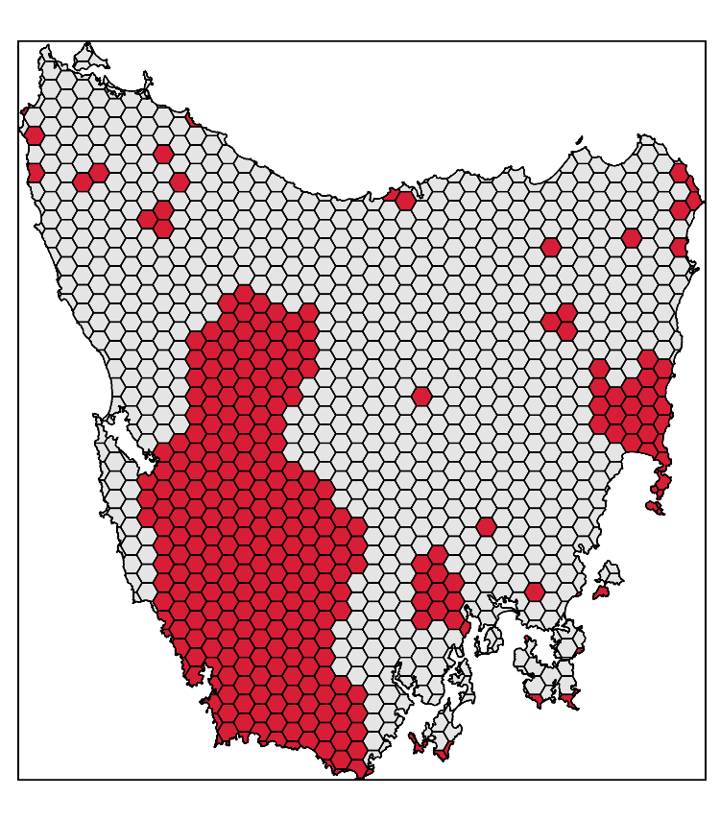
Design your problem
problem(tas_pu, tas_features,
"cost") %>%
add_min_set_objective() %>%
add_relative_targets(0.1) %>% add_locked_in_constraints("in") %>%
add_locked_out_constraints("out") %>%
add_boundary_penalties(0.01, 0.5) %>%
add_binary_decisions() %>%
add_gurobi_solver(gap = 0) %>% solve()

Slide 13
Design your problem
Objectives
add_max_features_objective
add_max_phylo_objective
add_max_utility_objective
add_min_set_objective
Penalties
add_connectivity_penalties
add_boundary_penalties
add_feature_weights
Decisions
add_bindary_decisions
add_proportion_decisions
add_semicontinuous_decisions
Constraints
add_feature_contiguity_constraints
add_contiguity_constraints
add_locked_in_constraints
add_locked_out_constraints
add_neighbour_constraints
Solvers
add_gurobi_solver
add_lpysmphony_solver
add_rsymphony_solver

Slide 14
Design your problem
problem(pu, fts, "cost") %>%
add_min_set_objective() %>%
add_relative_targets(…) %>% add_binary_decisions() %>%
solve()
Single zone
problem
problem(pu, zones(fts_z1, fts_z2, …),
c("cost_1", "cost_2", …)) %>%
add_min_set_objective() %>%
add_relative_targets(…) %>% add_binary_decisions() %>%
solve()
Multi-zone
problem

Slide 15
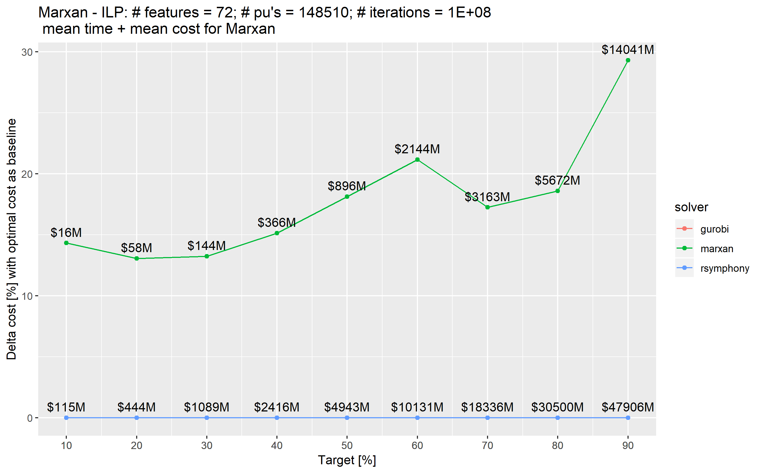
Exact algorithms guarantee optimality

Slide 16
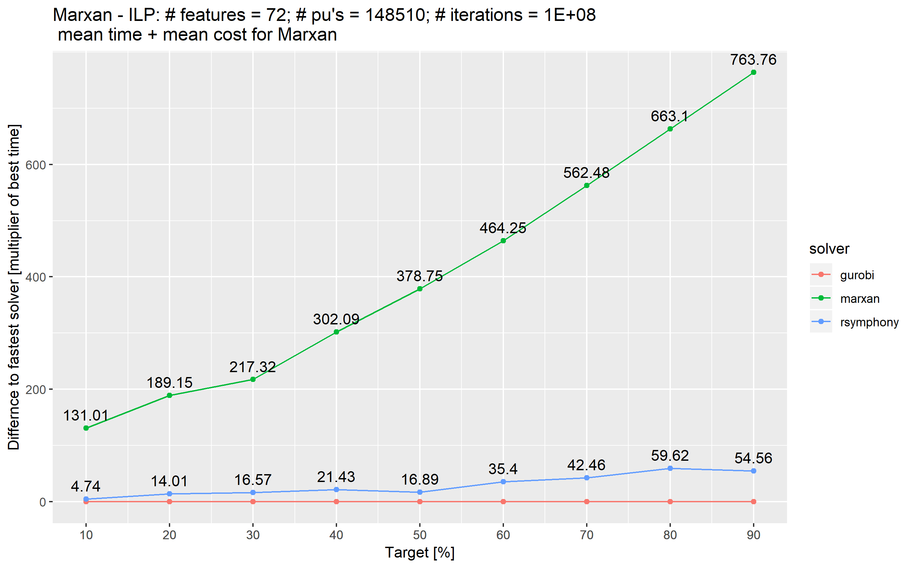
Exact algorithms are fast

Slide 17
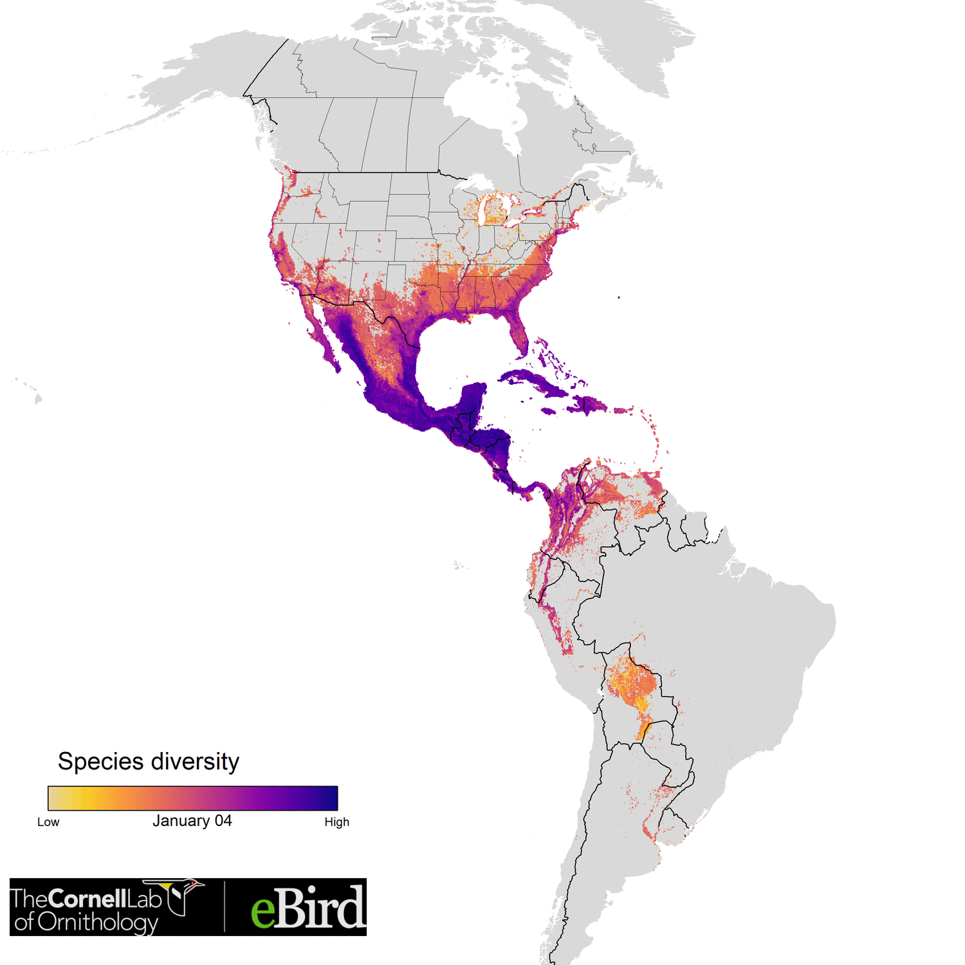

Optimizing the conservation of migratory species over their full annual cycle
117 species
73 million km²
1.7 million unique locations
14 million checklists
≤ 30,420 features
1.05 million planning units
Analysis powered by:
Schuster et al. (accepted) Nature Communications

Slide 18


The vision
Flexible + powerful framework
+ User friendly (browser) interface
= A novice stakeholder can devise a high-quality, data-driven spatial plan in just one hour.
prioritizr.net

Slide 19

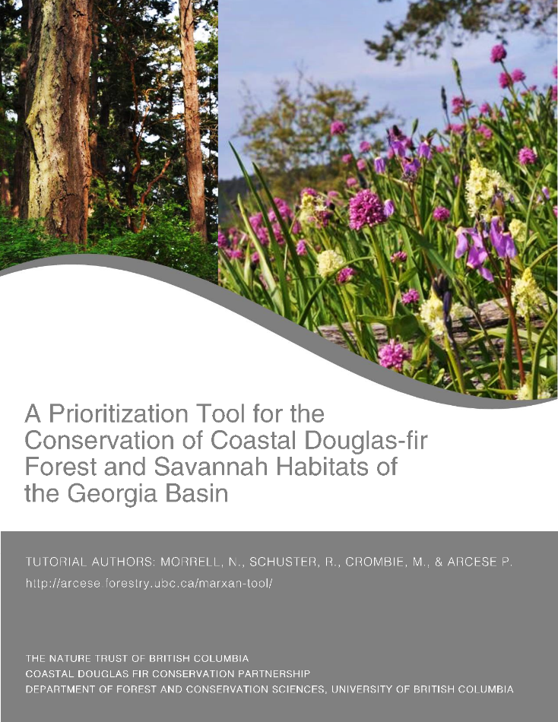
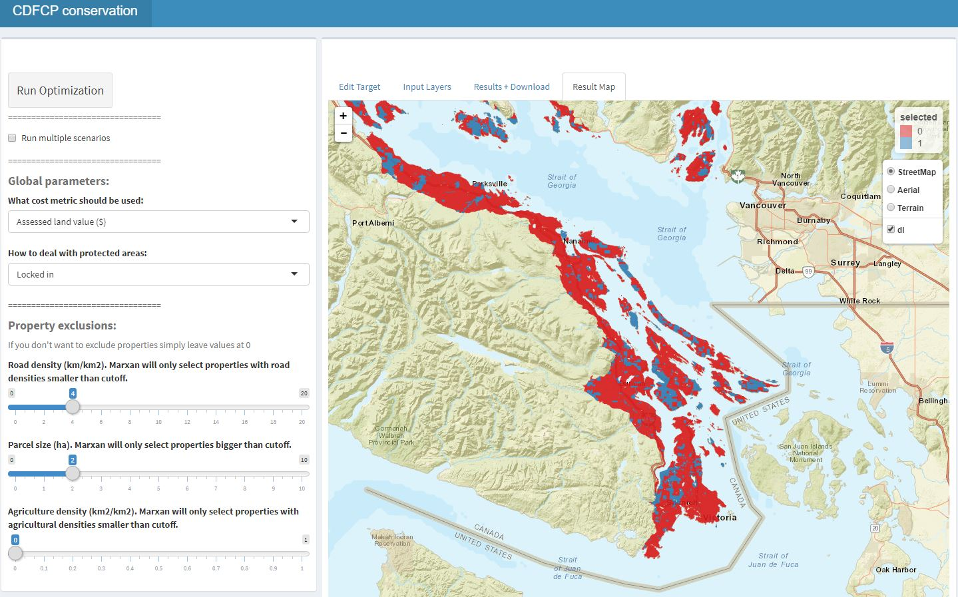
Making prioritizr user friendly:

Slide 20











Facilitate Consensus Decisions on Protection

Slide 21






Climate Adaptive Planning for British Columbia
Just got funding for a 3 years
Leads: Oscar Venter and Peter Arcese
Partners:

Slide 22
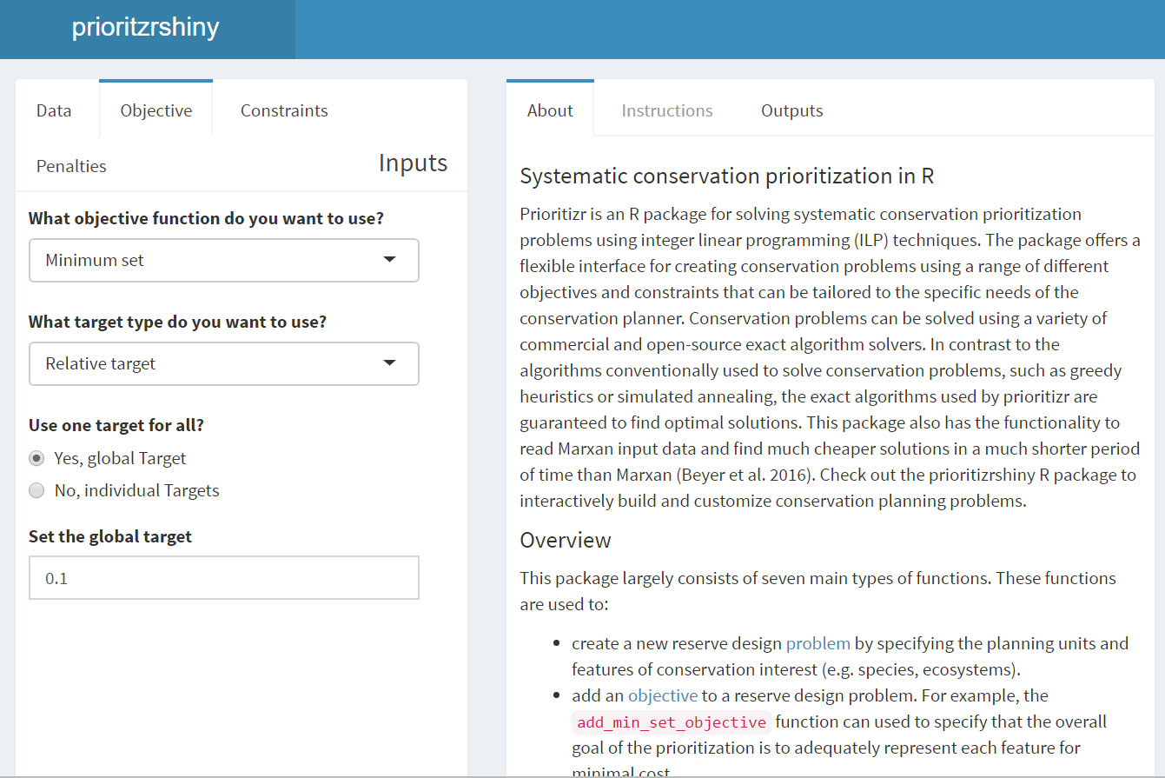
prioritizrshiny
Code
User interface
p <- problem(areas, feats) %>%
add_min_set_objective() %>%
add_relative_targets(0.1) %>%
add_boundary_penalties(5) %>%
add_binary_decisions() %>%
add_rsymphony_solver()
solution <- solve(p)

Slide 23
Take home message
Flexible + powerful framework
+ User friendly browser interface
= A novice stakeholder can devise a high-quality, data-driven spatial plan in just one hour.
prioritizr.net
jeffrey.hanson@uqconnect.edu.au
richard.schuster@glel.carleton.ca

